Slide 1

“Money Transfer”
Task - 2

Slide 2

MoneyꢀTransfer
▪ Itꢀisꢀanꢀapplicationꢀbuiltꢀforꢀtransferringꢀmoneyꢀfromꢀ
one’sꢀaccountꢀtoꢀanotherꢀperson’sꢀaccount.
LMS Username
2115a439
Name
M.PRAGTHIYUMNAN
M.HARIHARAN
K.GOKULRAJ
Batch
A4
2115a416
A4
A4
A4
2115a415
2115a429
KAVIN KUMAR

Slide 3

Taskꢀ-ꢀ2
CreateꢀUIꢀandꢀimplementꢀvariousꢀcomponentsꢀusingꢀreact
●
●
●
SplitꢀdesignꢀintoꢀcomponentsꢀandꢀHigherꢀorderꢀComponents
Defineꢀstructureꢀofꢀtheꢀcomponents
Setꢀtheꢀbasicꢀuiꢀcomponentsꢀwithꢀdummyꢀdata
IntegrateꢀtheꢀAPIsꢀtoꢀfrontendꢀtoꢀensureꢀtheꢀdynamicꢀfeatureꢀofꢀwebsite
●
●
●
●
●
Pointꢀbaseꢀapiꢀtoꢀtheꢀseversꢀbaseꢀurlꢀ
Designꢀapiꢀcallsꢀforꢀeachꢀelementꢀ
Handleꢀerrorsꢀinꢀtheꢀoutput
Renderꢀoutputꢀofꢀapisꢀtoꢀdifferentꢀlowꢀlevelꢀcomponents
Secureꢀcontentꢀofꢀpostꢀapisx
EvaluationꢀMetric:
● 100%ꢀCompletionꢀofꢀtheꢀaboveꢀtasks
Learning Outcome
▪
▪
▪
▪
DevelopingꢀcomplicatedꢀUIꢀusingꢀreactꢀcomponents
Usingꢀpropsꢀdrillingꢀandꢀcontextꢀtoꢀpassꢀvariables
Gettingꢀfamiliarꢀwithꢀdifferentꢀtypeꢀofꢀapiꢀcalls
Handlingꢀdifferentꢀinputꢀdata

Slide 4

Step-WiseꢀDescription
• First step , the structure of the application is
created using html .
• Secondly , using css the interface made
easier and attractive to use.
• Thirdly , using javascript the interaction with
the application is made easier and smoother.
Summaryꢀofꢀyourꢀtask
Front end part of the money transfer application is
done .

Slide 5

AssessmentꢀParameter
SetupꢀProjectꢀforꢀCalculatorꢀ
project
Setupꢀbasicꢀstructureꢀofꢀtext-
editorꢀproject
Createꢀaꢀmainꢀcomponentꢀwithꢀtheꢀ
outerꢀstructureꢀofꢀcalculator
Check-List
Createꢀmainꢀcomponentꢀwithꢀ
allꢀfeatureꢀbuttons
Createꢀaꢀbuttonꢀcomponentꢀ
withꢀonꢀclickꢀhandler
Createꢀaꢀjsonꢀobjectꢀtoꢀstoreꢀ
dataꢀforꢀtextꢀeditor
Createꢀaꢀ`ꢀevaluateExpresion`ꢀ
functionꢀtoꢀevaluateꢀvalue
Pushꢀbothꢀcodeꢀtoꢀgithub

Slide 6
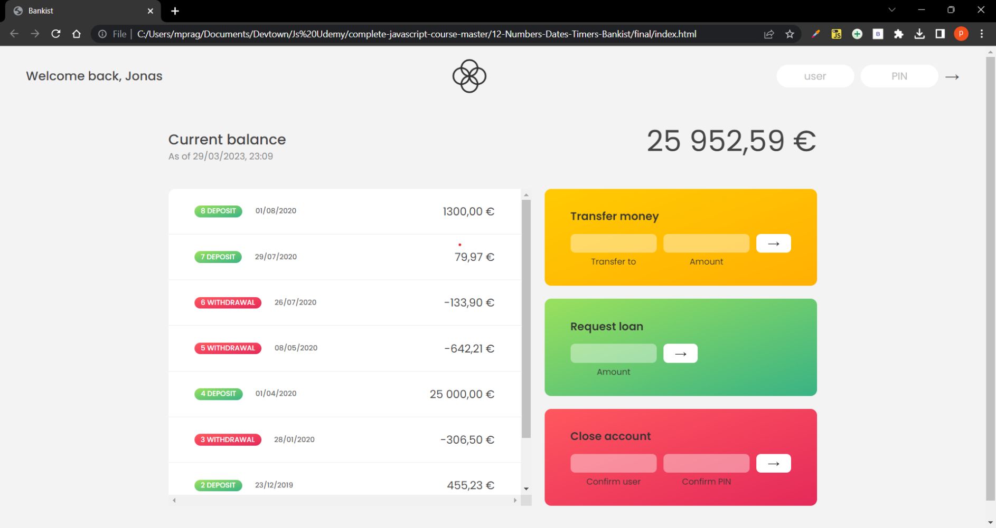
Screenshot of working model of money transfer application :

Slide 7

Submission Github
https://github.com/kavinkumar0/Moneytransfer

Slide 8


